Slide 1


Slide 2
About Today…
PostgresQL
Create
Read
Update
Delete

Slide 3
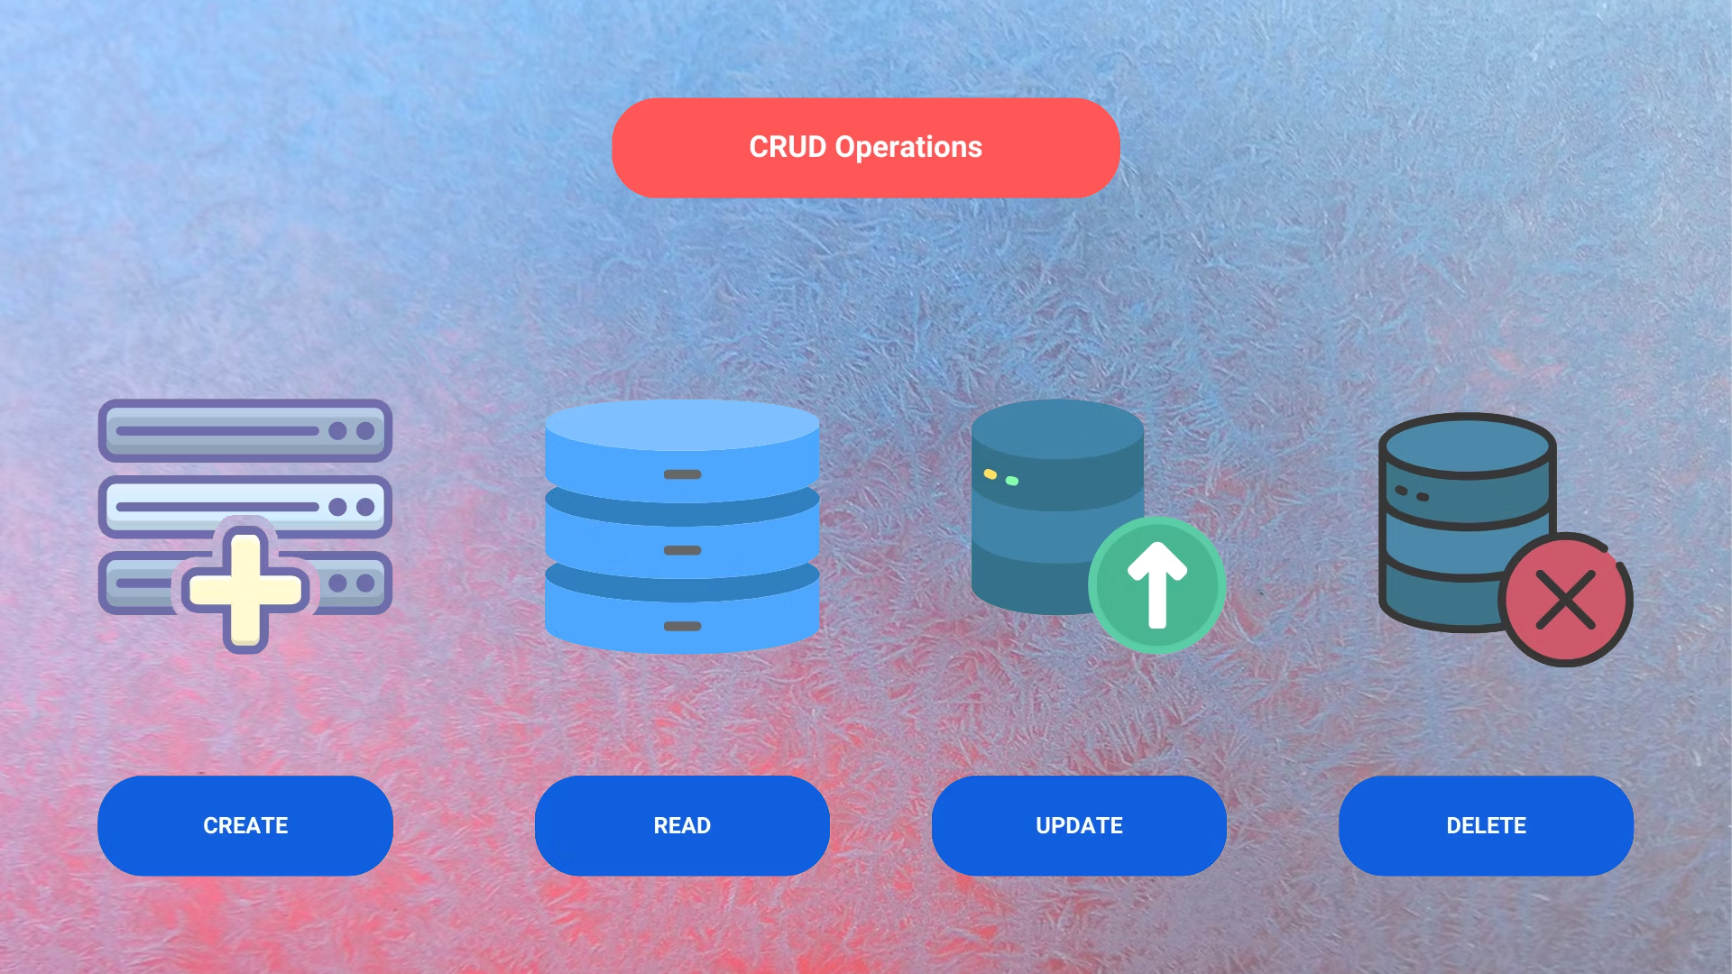

Slide 4
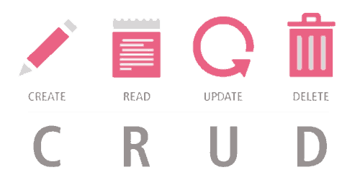
Overview
Create
Adding new data
Read
Retrieving data
Update
Modifying existing data
Delete
Removing data

Slide 5


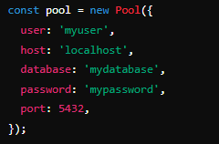
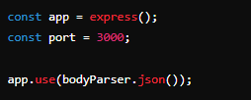
Setup
Install Necessary Packages
Basic Express Server Setup

Slide 6


Slide 7
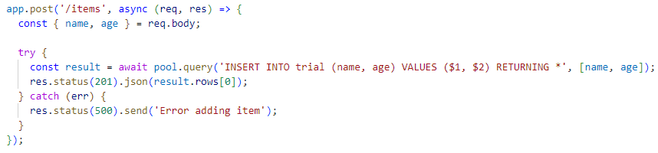
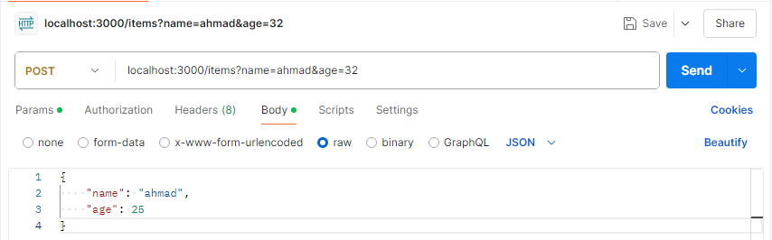
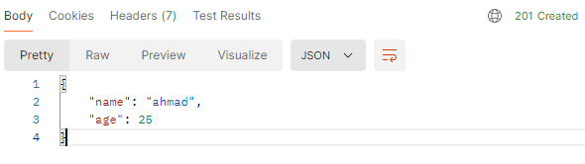


Slide 8


Slide 9
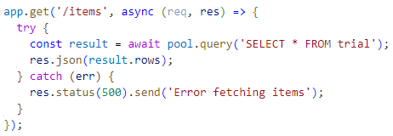
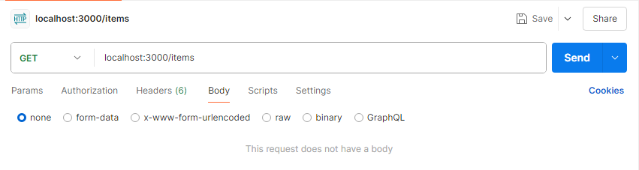
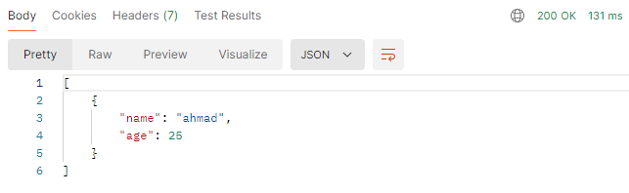

Slide 10


Slide 11
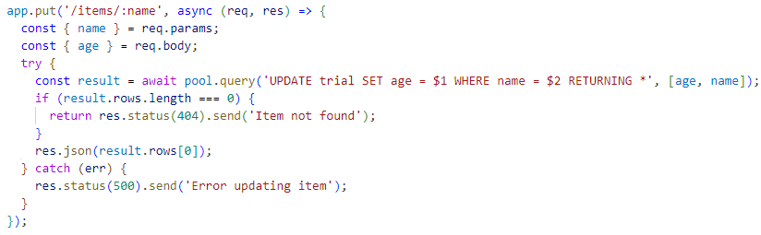
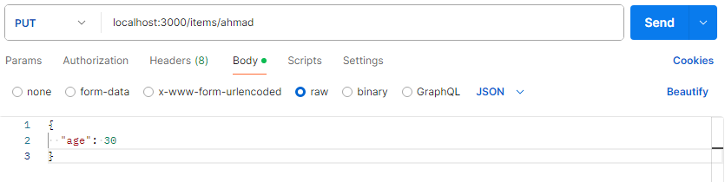
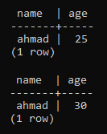
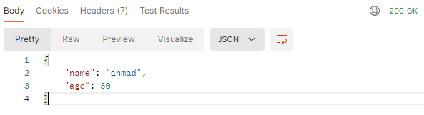
Before
After

Slide 12


Slide 13
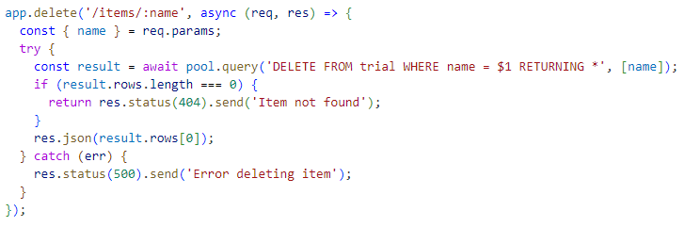
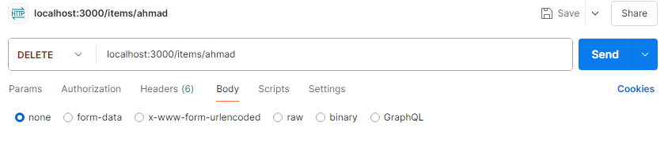
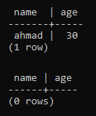
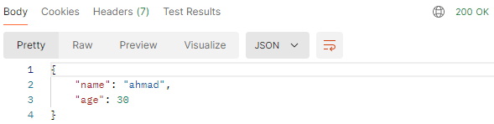
Before
After

Slide 14

What HTTP method is typically used to create a new resource in a RESTful API?
POST
Which HTTP method is used to retrieve data from the server?
GET
To update an existing resource, which HTTP method should be used?
PUT or PATCH
What is the purpose of the DELETE HTTP method in a RESTful API?
To delete a resource
which Express.js middleware is often used to parse incoming request bodies containing JSON?
body-parser

Slide 15

Task
Create an express app which perform CRUD operation on PostgreSQL database

